Slide 1

Basics of Web Design
Fifth Edition
Chapter 1
Internet & Web Basics Key Concepts
Slide in this Presentation Contain Hyperlinks. JAWS users should be able to get a list of links by using INSERT+F7
Copyright © 2019 Pearson Education, Inc. All Rights Reserved
Notes:
If this PowerPoint presentation contains mathematical equations, you may need to check that your computer has the following installed:
1) Math Type Plugin
2) Math Player (free versions available)
3) NVDA Reader (free versions available)

Slide 2
Learning Outcomes
Describe the evolution of the Internet and the Web
Explain the need for web standards
Describe universal design
Identify benefits of accessible web design
Identify reliable resources of information on the Web
Identify ethical use of the Web
Describe the purpose of web browsers and web servers
Identify Internet protocols
Define U R I s and domain names
Describe H T M L
Create your first web page
Use the body, head, title and meta elements
Name, save, and test a web page

Slide 3
The Evolution of the Internet
Internet
Interconnected network of computer networks
A R P A net
Advanced Research Project Agency
1969 – four computers connected
N S F net
National Science Foundation
Use of the Internet was originally limited to government, research and academic use
1991 Commercial ban lifted

Slide 4
The World Wide Web
The graphical user interface to information stored on some of the computers connected to the Internet.

Slide 5
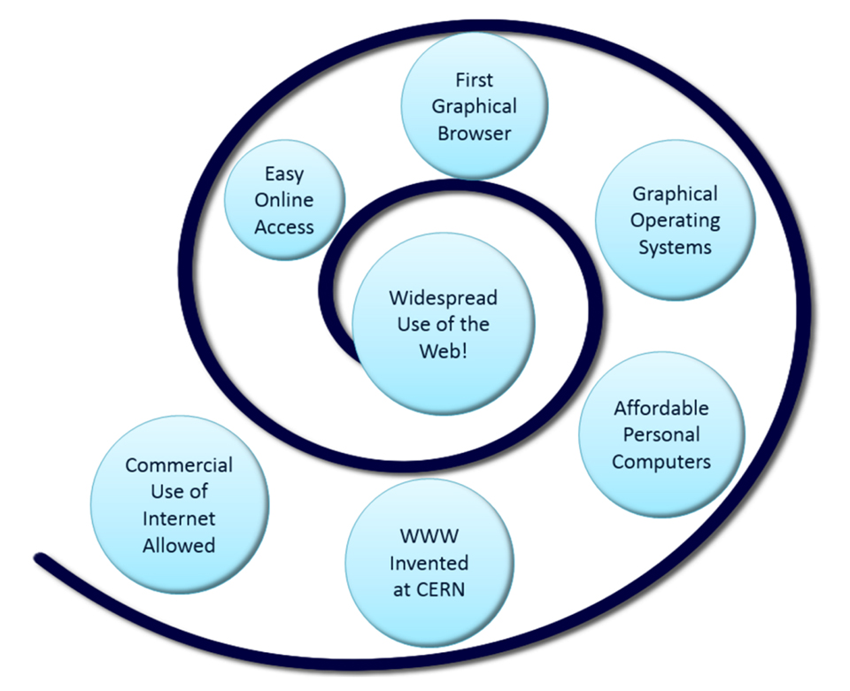
Convergence of Technologies (1 of 2)

Slide 6
Convergence of Technologies (2 of 2)
Removal of the ban on commercial activity
Development of the World Wide Web at C E R N
Development of the first graphics-based web browser named Mosaic at N C S A
Affordable personal computers with G U I operating systems
Affordable Internet Service Providers

Slide 7
Web Standards and the W 3 C Consortium
W 3 C – World Wide Web Consortium
Develops recommendations and prototype technologies related to the Web
Produces specifications, called Recommendations, in an effort to standardize web technologies
W A I – Web Accessibility Initiative

Slide 8
Web Accessibility (1 of 2)
“The power of the Web is in its universality.
Access by everyone regardless of disability
is an essential aspect.” – Tim Berners-Lee
Accessible Websites provide accommodations that help individuals to individuals with visual, auditory, physical, and neurological disabilities overcome barriers
W A I – Web Accessibility Initiative
Develops accessibility recommendations
W C A G 2.0
W C A G 2.1 – expands W C A G 2.0
Web Content Accessibility Guidelines http://www.w3.org/WAI/WCAG20/quickref/

Slide 9
Web Accessibility (2 of 2)
Section 508 of the Rehabilitation Act
Requires that government agencies must give individuals with disabilities access to information technology that is comparable to the access available to others
Aligned to W C A G 2.0

Slide 10
Universal Design
A “strategy for making products, environments, operational systems, and services welcoming and usable to the most diverse range of people possible.”
https://www.dol.gov/odep/topics/UniversalDesign.htm

Slide 11
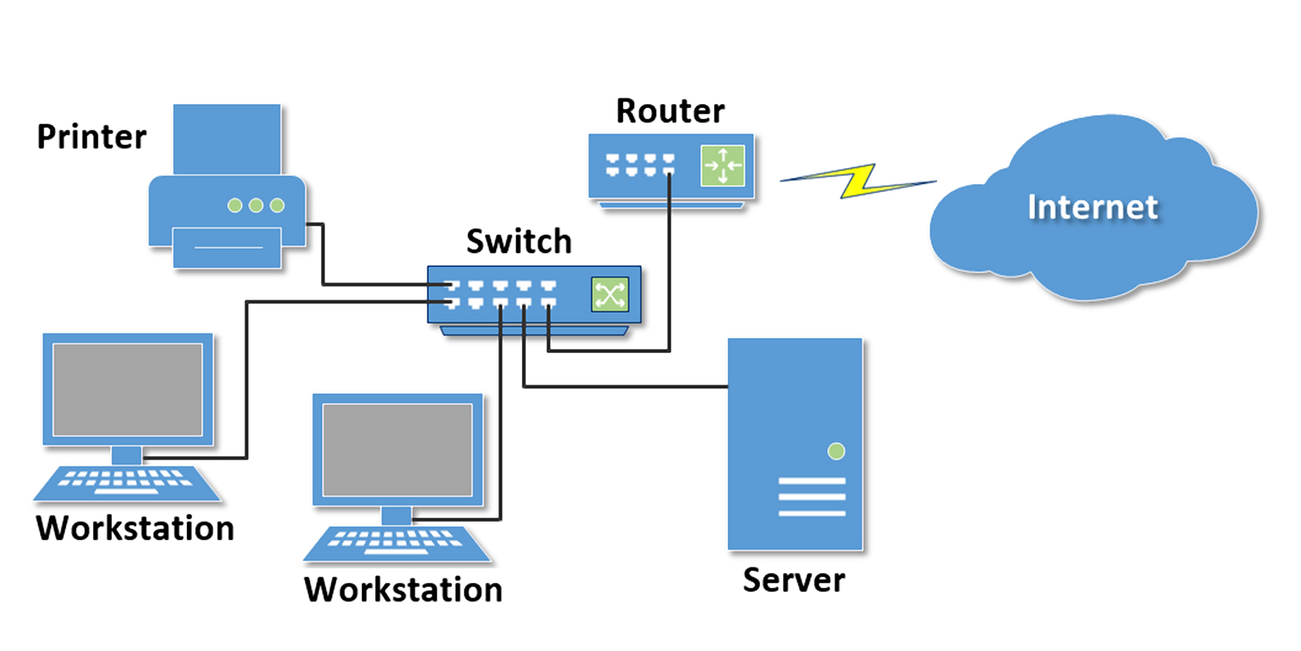
Network Overview
Network
two or more computers connected together for the purpose of communicating and sharing resources

Slide 12
The Client/Server Model (1 of 2)
Client/Server can describe a relationship between two computer programs – the "client" and the "server".
Client
requests some type of service (such as a file or database access) from the server.
Server
fulfills the request and transmits the results to the client over a network

Slide 13
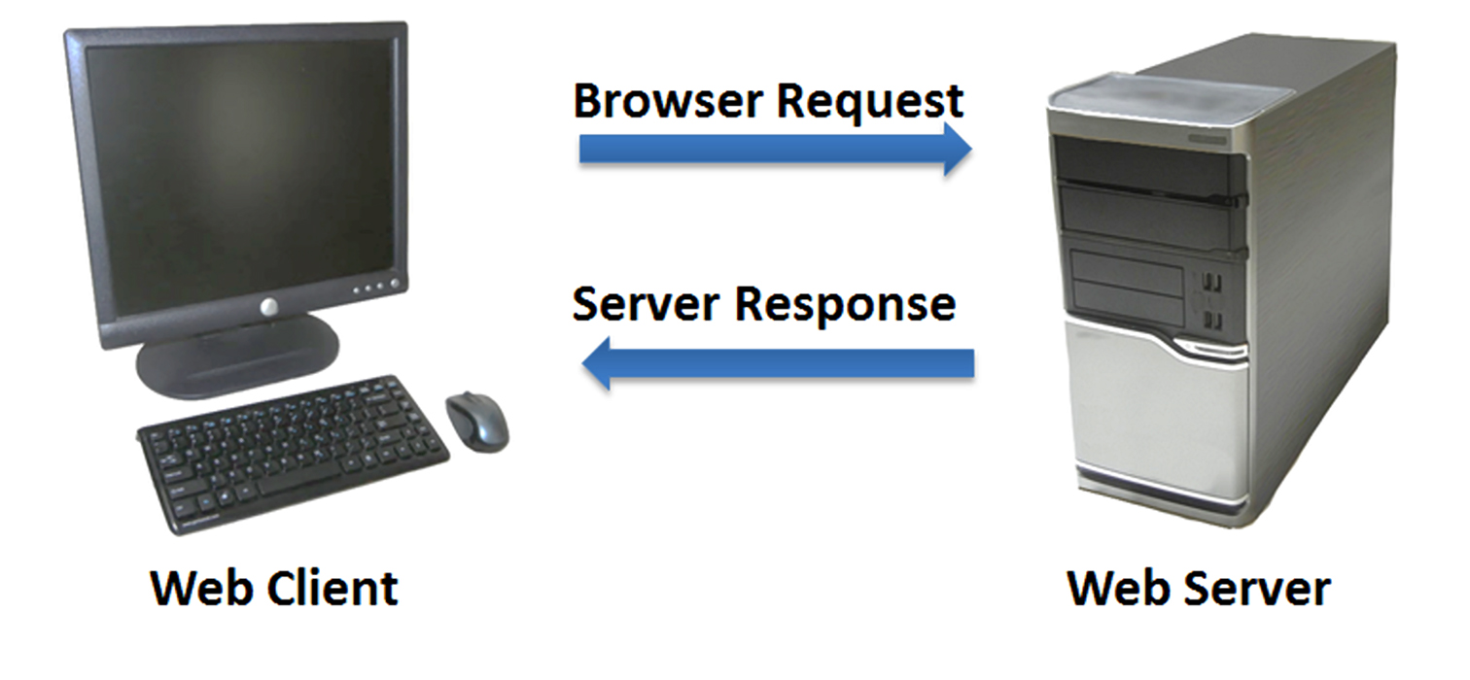
The Client/Server Model (2 of 2)
The Internet Client/Server Model
Client: Web Browser
Server: Web Server

Slide 14
Internet Protocols
Protocols
Rules that describe the methods used for clients and servers to communicate with each other over a network.
There is no single protocol that makes the Internet and Web work.
A number of protocols with specific functions are needed.

Slide 15
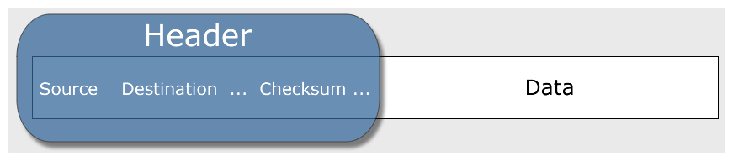
Common Internet Protocols
Official Communication Protocol: T C P/I P
Specialized Protocols:
File Transfer: F T P
E-mail: S M T P, P O P 3, I M A P
Websites: H T T P, H T T P/2

Slide 16
H T T P Hypertext Transfer Protocol
A set of rules for exchanging files such as text, graphic images, sound, video, and other multimedia files on the Web.
Web browsers send H T T P requests for web pages and their associated files.
Web servers send H T T P responses back to the web browsers.

Slide 17
I P Address
Each device connected to the Internet has a unique numeric I P address.
These addresses consist of a set of four groups of numbers, called octets.
216.58.194.46 will get you Google!
An I P address may correspond to a domain name.

Slide 18
Domain Name
Locates an organization or other entity on the Internet
Domain Name System
Divides the Internet into logical groups and understandable names
Associates unique computer I P Addresses with the text-based domain names you type into a web browser
Browser: http://google.com
I P Address: 216.58.194.46

Slide 19
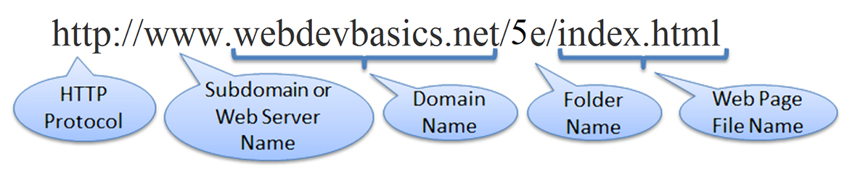
U R I Uniform Resource Indicator
U R L
Uniform Resource Locator
Represents the address of a resource on the Internet.

Slide 20
T L D Top-Level Domain Name
A top-level domain (T L D) identifies the right-most part of the domain name.
Some generic T L D s:
.com, .org, .net, .mil, .gov, .edu, .int, .aero, .asia, .cat, .jobs, .name, .biz, .museum, .info, .coop, .pro, .travel

Slide 21
New g T L D s!
As of 2017, there were over 1,500 T L D s
New g T L D s to become available included .bike, .guru, .holdings, .clothing, .singles, .ventures, and .plumbing.
I C A N N has set a schedule to periodically launch new g T L D s.
http://newgtlds.icann.org/en/program-status/delegated-strings
for a list of new g T L D s.

Slide 22
County Code T L D s
Two character codes originally intended to indicate the geographical location (country) of the web site.
In practice, it is fairly easy to obtain a domain name with a country code T L D that is not local to the registrant.
Examples:
.tv, .ws, .au, .jp, .uk
See http://www.iana.org/domains/root/db for a list of T L D s.

Slide 23
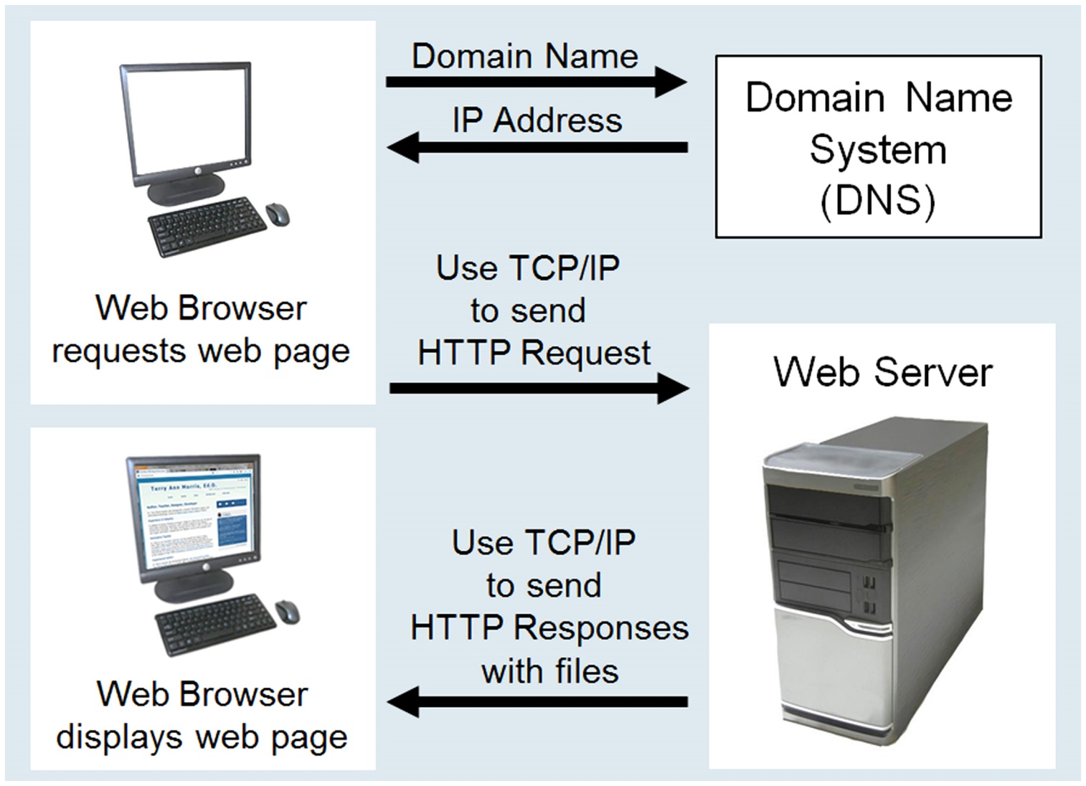
Domain Name System
The Domain Name System (D N S) associates Domain Names with I P addresses.

Slide 24
Information on the Web
Reliability and information
Evaluate the credibility of the site
Ethical use of information
Copyright and the Web

Slide 25
Markup Languages (1 of 4)
S G M L – Standard Generalized Markup Language
A standard for specifying a markup language or tag set
H T M L – Hypertext Markup Language
The set of markup symbols or codes placed in a file intended for display on a web browser.
Element or tag – individual markup code
Attribute – modifies the purpose of a tag

Slide 26
Markup Languages (2 of 4)
X M L – eXtensible Markup Language
A text-based language designed to describe, deliver, and exchange structured information.
It is not intended to replace H T M L – it is intended to extend the power of H T M L by separating data from presentation.

Slide 27
Markup Languages (3 of 4)
X H T M L – eXtensible Hypertext Markup Language
Developed by the W 3 C as the reformulation of H T M L 4.0 as an application of X M L.
It combines the formatting strengths of H T M L 4.0 and the data structure and extensibility strengths of X M L.

Slide 28
Markup Languages (4 of 4)
H T M L 5 – Recommendation Status 2014
The successor to H T M L 4
Replaces X H T M L
Incorporates features of both H T M L and X H T M L
Adds new elements
Eliminates some elements
Intended to be backward compatible
Constantly evolving…
H T M L 5.1 – Recommendation Status 2016
H T M L 5.2 – Recommendation Status 2017
http://www.w3.org/html/

Slide 29
Your First H T M L 5 Web Page: index.html
<!DOCTYPE html">
<html lang="en">
<head>
<title>Page Title Goes Here</title>
<meta charset="utf-8">
</head>
<body>
... body text and more H T M L tags go here ...
</body>
</html>

Slide 30
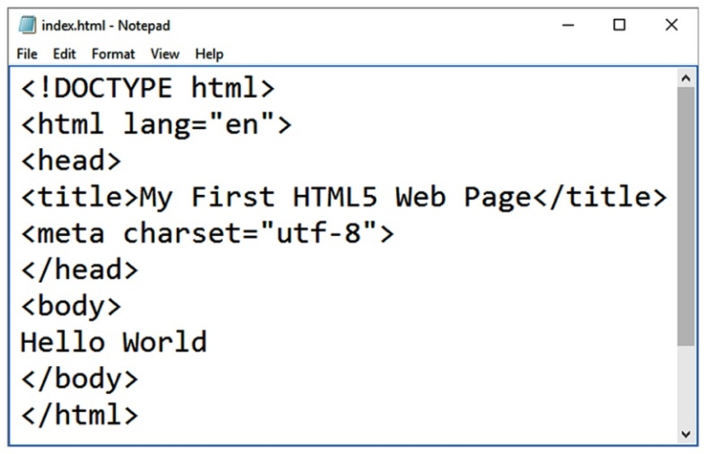
Under the Hood of a Web Page
D T D – describes the markup language syntax
H T M L element– contains the web page document
Head element – contains the head section
The head section contains information that describes the web page document.
Title element – Text displays in title bar of window
Meta element – describes the character encoding
Body element – contains the body section
The body section contains the text and elements that display in the browser viewport.

Slide 31
Summary
This chapter provided a brief overview of Internet, Web, and introductory networking concepts along with your very first web page.

Slide 32

Copyright
This work is protected by United States copyright laws and is provided solely for the use of instructors in teaching their courses and assessing student learning. Dissemination or sale of any part of this work (including on the World Wide Web) will destroy the integrity of the work and is not permitted. The work and materials from it should never be made available to students except by instructors using the accompanying text in their classes. All recipients of this work are expected to abide by these restrictions and to honor the intended pedagogical purposes and the needs of other instructors who rely on these materials.

